Slide 1
2018 report figures/stats

Slide 2
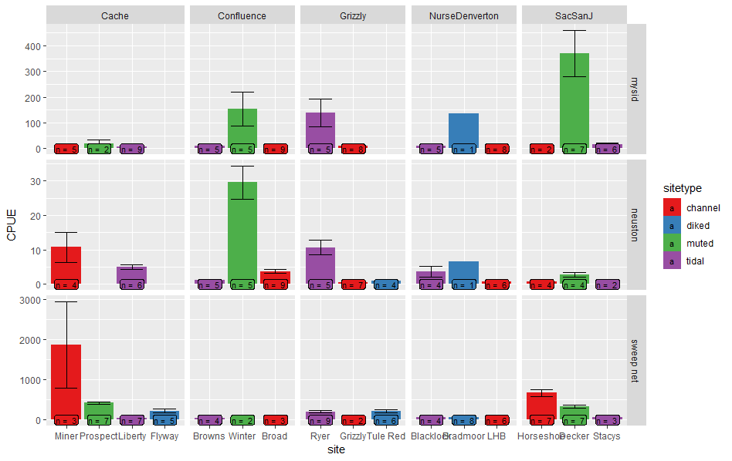
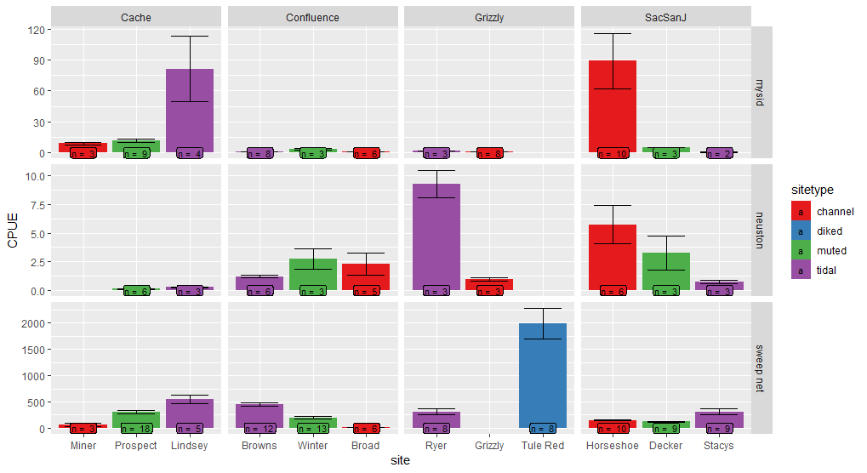
CPUE
2017
2018

Slide 3
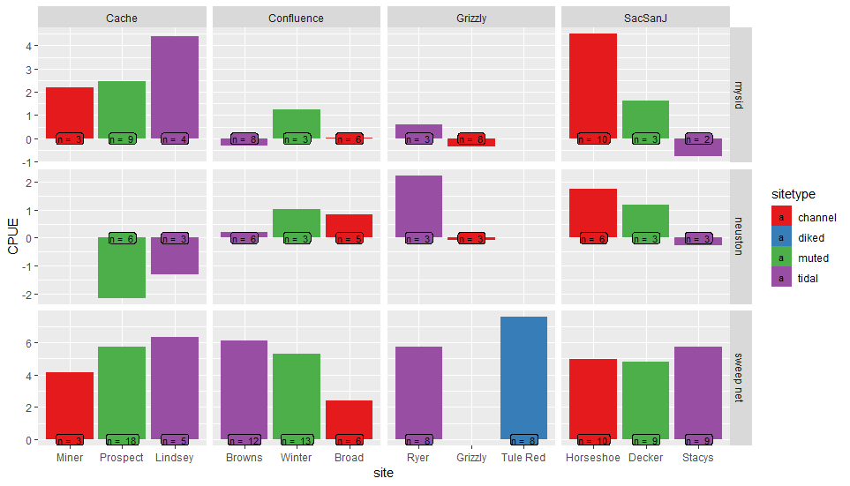
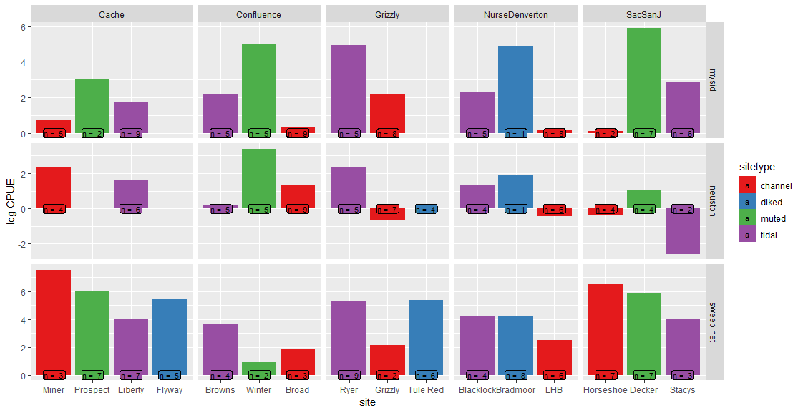
CPUE –log transformed

Slide 4
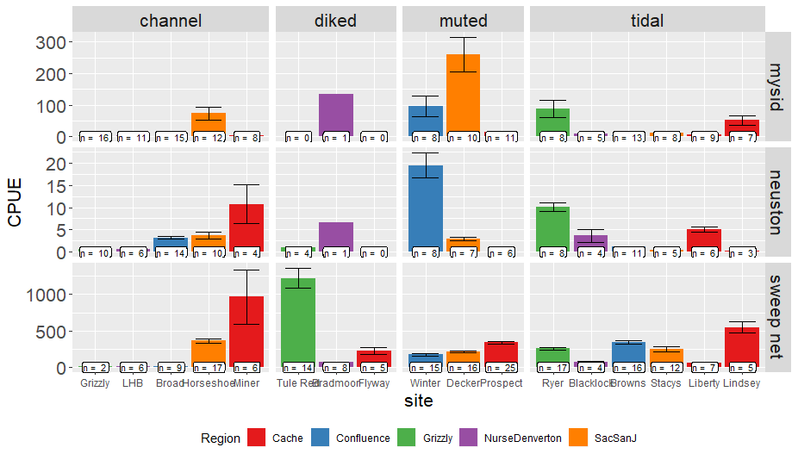
CPUE – both years together

Slide 5
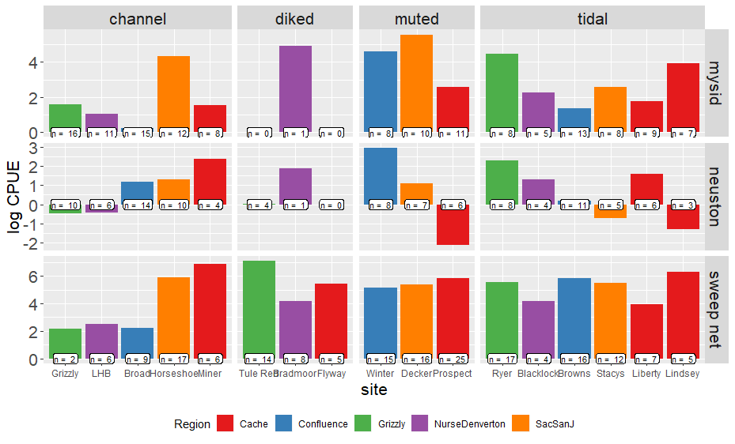
CPUE – log-transformed

Slide 6
GLMM
Log(CPUE+1) ~ Gear + sitetype + Error(Site)
 | Estimate | Std. Error | df | t value | Pr(>|t|)
(Intercept: mysid, channel) | 1.194 | 0.233 | 14.85 | 5.116 | 0.000131 | ***
Gear:Neuston | -0.6006 | 0.178 | 416.9 | -3.374 | 0.000809 | **
Gear: Vegetation | 2.6546 | 0.1666 | 421.7 | 16.256 | < 2e-16 | ***
Diked wetland | 1.155 | 0.4192 | 19. 83 | 2.755 | 0.0122 | *
Muted tidal wetland | 0.9758 | .3511 | 10.74 | 2.78 | 0.0183 | *
Tidal wetland | 0.6102 | 0.3005 | 11.998 | 2.031 | 0.0650 | *
Post-hoc shows wetland sites have higher catch overall from channel sites, but wetlands are not different from each other.
Earlier analyses with AIC did not support use of Year or Region as predictor variables

Slide 7
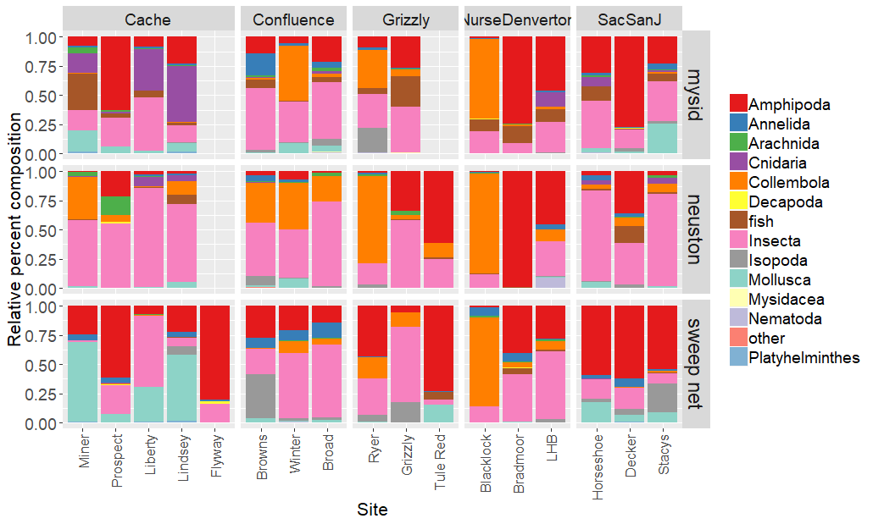

Slide 8
Multivariates
Permanova
 | Df | SumsOfSqs | MeanSqs | F.Model | R2 | Pr(>F)
Region | 4 | 6. 861 | 1.715 | 11.305 | 0.073 | 0.001 | ***
SiteType | 3 | 8.527 | 2.841 | 18.733 | 0.091 | 0.001 | ***
Habitat | 2 | 7.960 | 3.979 | 26.232 | 0.0849 | 0.001 | ***
site | 9 | 7.629 | 0.848 | 5.587 | 0.081 | 0.001 | ***
Residuals | 414 | 62.811 | 0.152 |  | 0.669
Total | 432 | 93.79 |  |  | 1

